Slide 2
What is Google Classroom?
This is an interactive online portal to store and transmit material to and from students.
They can use it on an iPad or iPhone but also on any internet site.
We can use it to lay out our courses for class access. Every topic could be covered and you can include your class notes ; presentations ; Worksheets ; WAGOLL answers, guides from exam boards; Past exam papers, YouTube videos and Weblinks
You can set assignments ; send a class message ; Ask a Question or upload learning material.
It is designed to augment your lessons and act as a teaching learning and revision tool.
We can put materials in this that we cannot put anywhere else. It is only open to our pupils. We give them codes for the classrooms they need which they sign into. This gives them full access to our material.
Each class has a unique code which you share with your pupils
You can have as many classes as you want

Slide 3
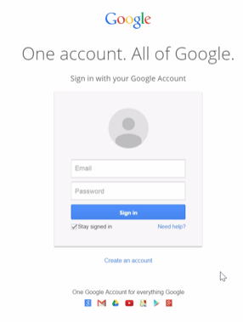
How do I log on and set up a Google Classroom on a PC?
Go to classroom.google.com (There is an app for the iPad too)
To log in use your c2k login but with @lagancollege.co.uk so for example jwishart786@lagancollege.co.uk
You should have a password – If you do not please email me and I will sort you out with one. I will always create a temporary password which is lagan1981 – It is really important that you use the @lagancollege.co.uk account.
Your Username is your c2k address @lagancollege.co.uk
If you don’t know your password just email John Wishart

Slide 4
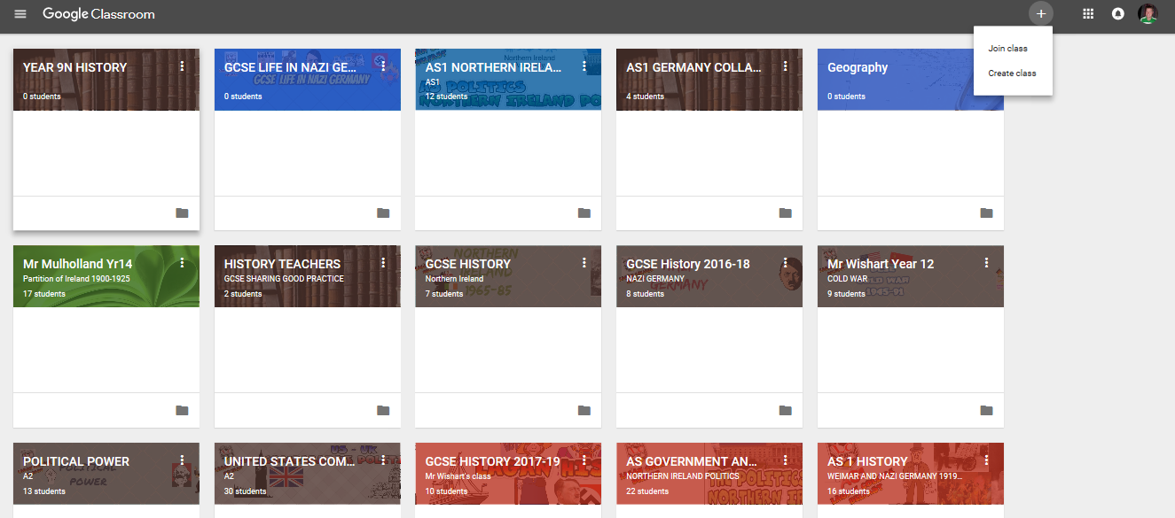
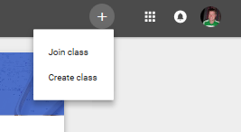
Go to the Top Right corner – You should see the + Button
This gives you the option to JOIN someone’s class
It also gives you the option to CREATE A CLASS
(We almost always go on as teachers to create a class)

Slide 5
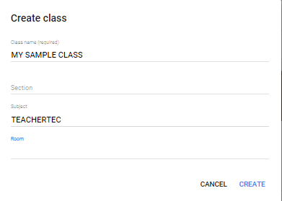
GO TO CREATE CLASS
Fill in the basics – What your class is called
REMEMBER to include the class name in full (eg 9N History) as there are lots of other classes from same subjects.
Click CREATE once finished

Slide 6
GOOGLE APPS
This allows you switch between and use all the other Google Apps
This Menu has all your classes
You have THREE Menus at the top
STREAM – Where all your work will be shown chronologically.
CLASSWORK – Where your pupil work is organised
PEOPLE – Shows who is in your class
THEME
You can switch the Picture theme for your classroom here or upload your own
SETTINGS
This allows you to see all your classroom settings – It is very useful to find your CLASS CODE

Slide 7
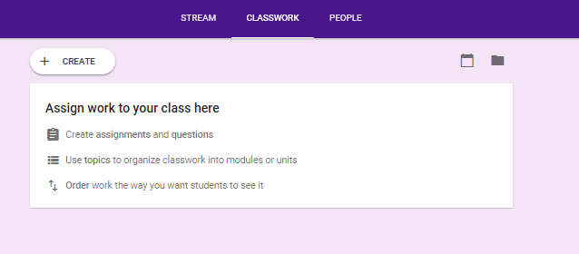
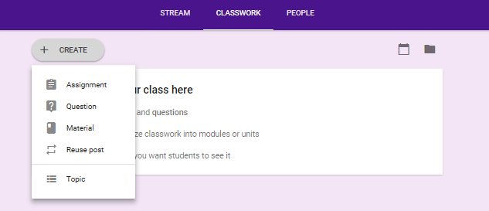
GO TO CLASSWORK in middle of Banner
I like to have a ‘skeleton’ of a structure – with all my topics laid out. I use CLASSWORK for this.
Go to + CREATE button
This provides a range of Options:
Setting Assignments
Asking a Question
Adding Material
Reusing a Post
We want to start with TOPIC

Slide 8
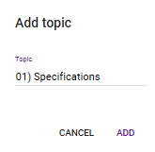
ADDING TOPICS
To create your Topic structure
Go to + CREATE
Click on TOPIC
Add your Topic – I suggest using 01) etc and naming it as it keeps them order
Think about including Course outline or Specifications first and then breaking up your curriculum into topics
Keep creating and adding until complete

Slide 9
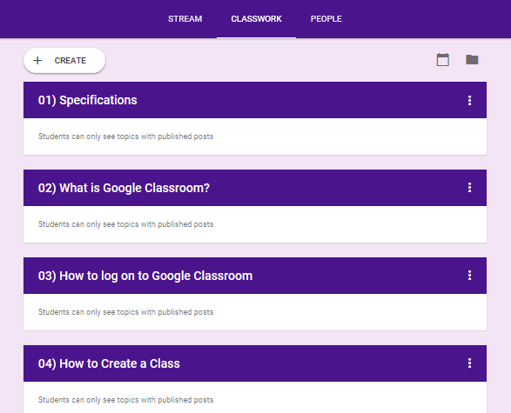
ADDING TOPICS
Your class should begin to look like this:
If you want to change anything just go to the three dots on right hand side and click Edit

Slide 10
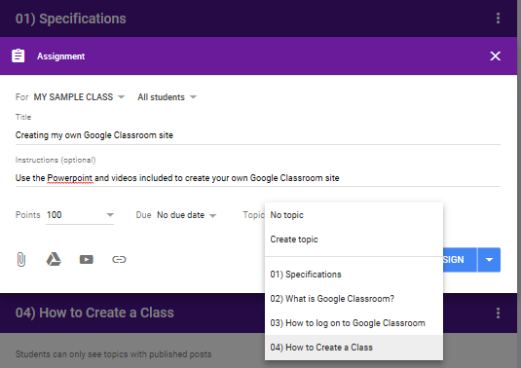
Go to + CREATE again
This time try to add an ASSIGNMENT
Add a TITLE
Add instructions if you want
You can choose the Points to award if you want
You can choose a date due or not
IMPORTANT: Attach the assignment to the TOPIC you wish by clicking the Topic menu and choosing the topic required.
You can add any files you have ; Google drive links; YouTube videos or weblinks from here.
Click ASSIGN

Slide 11
Other Options
Your work should look like this when assigned
Don’t forget you can do exactly the same with the other options - eg You can ask a question ; You can add material.
You can do this multiple times in the same topic – To add anything later just click the three dots and edit

Slide 12
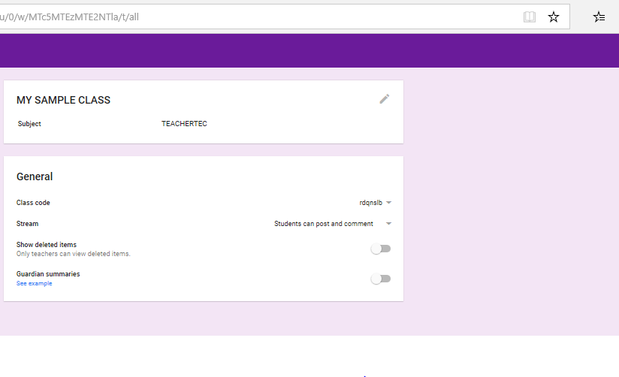
Very important
For pupils to access :
They have to go on the iPad and join your class using the class code
OR
Go to classroom.google.com and log in
Most pupils should now have access to google using their @lagancollege.co.uk details. – It is VERY IMPORTANT – that they use this to log in and not any other emails as the others will not work
YOU CAN FIND THE CLASS CODE BY CLICKING ON SETTINGS AT THE TOP – THE CODE IS A SET OF LETTERS AND NUMBERS SHOWN UNDER GENERAL > CLASS CODE.
The Pupils will join your class using this.

Slide 13
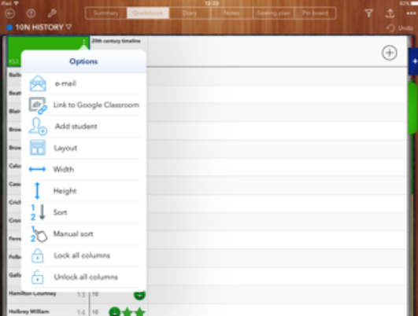
Useful tip:
The beauty about Google Classroom is that it is linked with so many other apps
You can connect it with your Idoceo classes and marksheets. Just click on the three dots on the left hand menu for the class you want
Click the LINK to Google Classroom option
Choose the right class from the classes there.

Slide 14
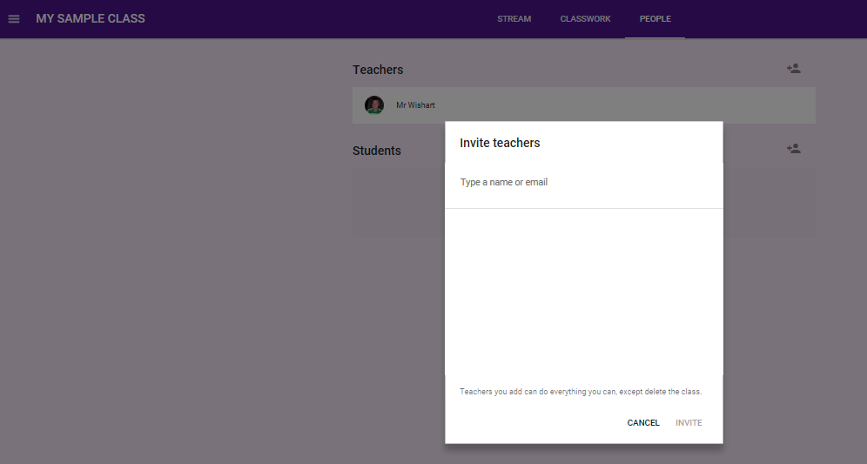
Collaborating
To save time and effort or to share best practice and even to have a digital Book Look you can share the classroom with another trusted teacher – This is really good for getting ideas or sharing resources or even classes
Just go to PEOPLE option
Click on the little person + button beside teachers and type in their email.
The other option is to set up one of the department to share resources

Slide 15
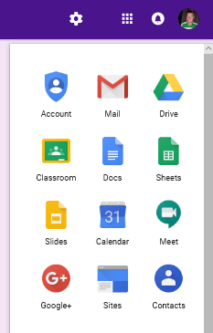
Useful tip:
One really useful thing to point out is that any material you upload is automatically uploaded to your own GOOGLE DRIVE ACCOUNT- This is cloud technology which allows you access to your material anywhere. This uses the same log in details to access. It also means if you forget your pen drive – everything is there for you.
You can also link it to your calendar and a host of other Google apps
You can access these at the top right hand side

